Slide 1

MYBRARY

Slide 2
INTRODUCTION OF THE PROJECT

Slide 3
. MODULE DESCRIPTION MODULE 1 – The ‘SEARCH’ operation has been used by us in our database which provides us with our main motive of the ‘COUNT’ of the books. Using the search operation we can search for the books we need to issue in order to see if it is still available. MODULE 2 – Our application has provided the users with an ‘i’ button which further includes three buttons; “ABOUT” , “HELP” and “SOCIALS”. MODULE 3 – For our web page we have used a software name ATOM with whose help we have uploaded our information on github.

Slide 4
.
ANDROID STUDIO
FIREBASE
CONNECTION
INSERT DATA IN FIREBASE
AGAIN ANDROID STUDIO
ACCESS RECYCLER VIEW
TO SEARCH DATA
SEARCH VIEW
XML FILE IN CARDVIEW LAYOUT
MYADAPTOR CLASS FOR XML FILE
IMPLEMENT CODE

Slide 5
MODULE WORK FLOW EXPLANATION
Make project
Connect the application to firebase
Insert the data that is accesable to firebase
Insert recycler view to display data
Make separate class with reference to database
Make an XML file for the displaying of search view in cardview layout
Then myadaptor class for the access of layout
Then implement the code

Slide 6
REAL TIME USAGE
Benefits to students.
They will save their time and effort of going to the library to check the availability of the books.
Benefits to teachers
They will know the exact number of books available in the library suggested by them

Slide 7
SOFTWARE REQUIREMENTS :
Android Studio with JAVA or KOTLIN
Firebase to link the database with Android Studio
HARDWARE REQUIREMENTS :
- Any basic android phone with a minimum of android 7.0

Slide 8
CHALLENGES

Slide 9
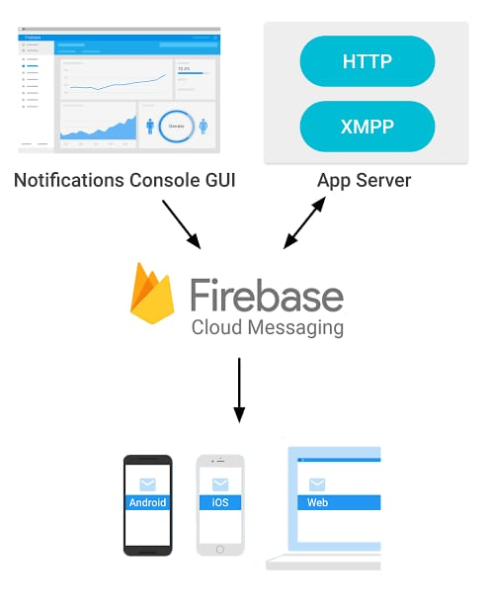
OVERALL SYSTEM ARCHITECTURE DESIGN

Slide 10
IMPLEMENTATION AND CODING
Android Studio
Firebase
JAVA

Slide 11
Members
There are four member
Ankita -- Java Programming and connected to the database
Vikas – Design
Rhea – She entered the data on the database
Manya – She Made the report of our project

Slide 12
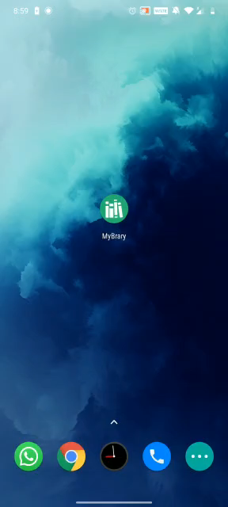
.
DEMO VIDEO

Slide 13
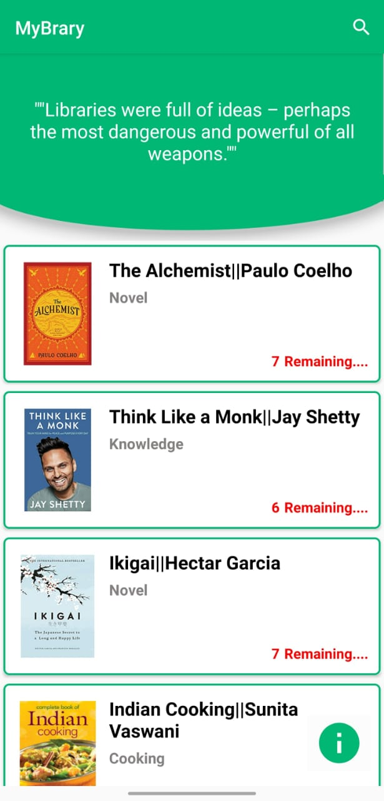
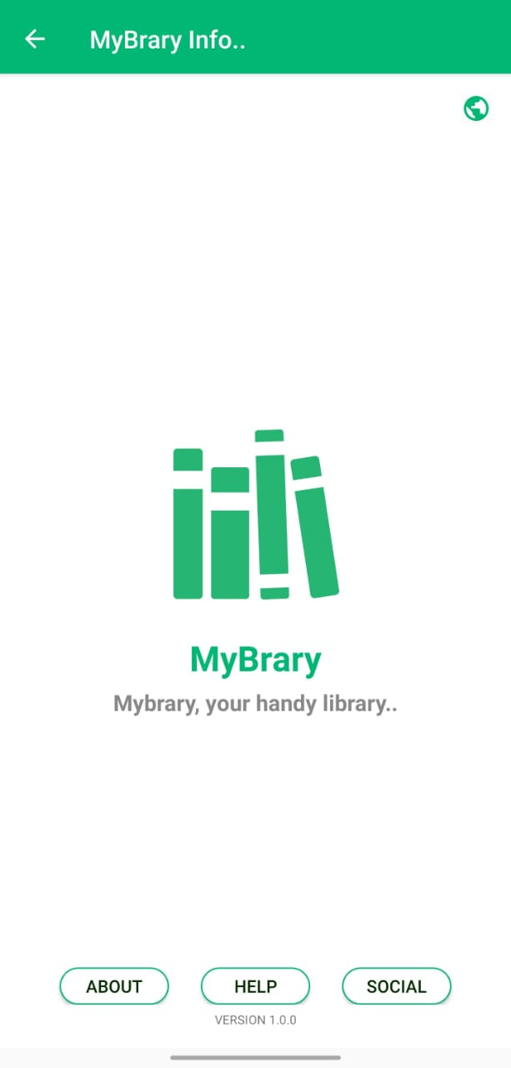
SNAPSHOT OF THE PROJECT
THE SEARCH BUTTON WHICH WILL GET A
PARTICULAR BOOK THAT IS SEARCHED FOR
THIS OPENS 'GOOGLE' BROWSER
FOR ANY ISSUE
THE 'i' BUTTON
THE 'i' BUTTON FUTHER OPENS TO ANOTHER PAGE WHICH HAS A BUTTON ON UPPER RIGHT HAND CORNER WHICH WHEB CLICKED OPENS TO 'GOOGLE' BROSWER.
WHEREAS THE BOTTOM OF THE PAGE HAS THREE BUTTONS; 'ABOUT', 'HELP' AND 'SOCIAL'

Slide 14
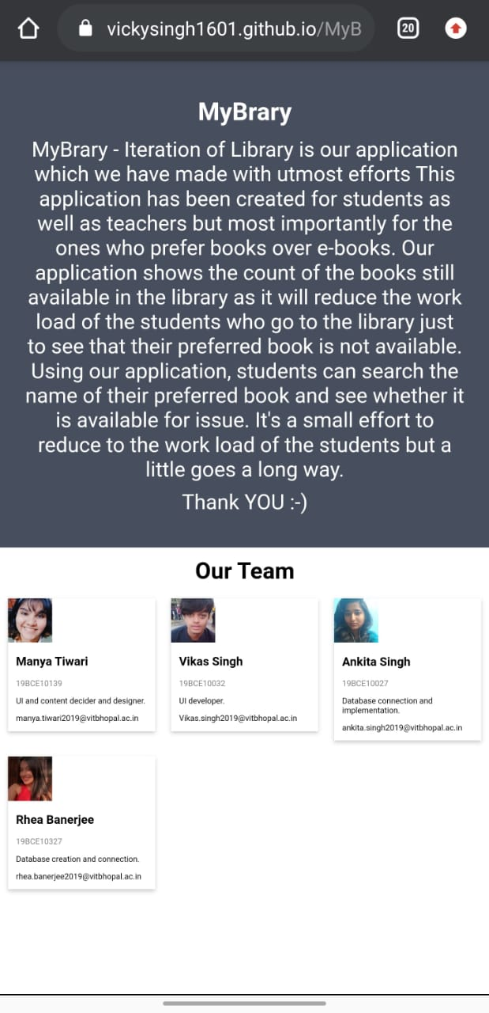
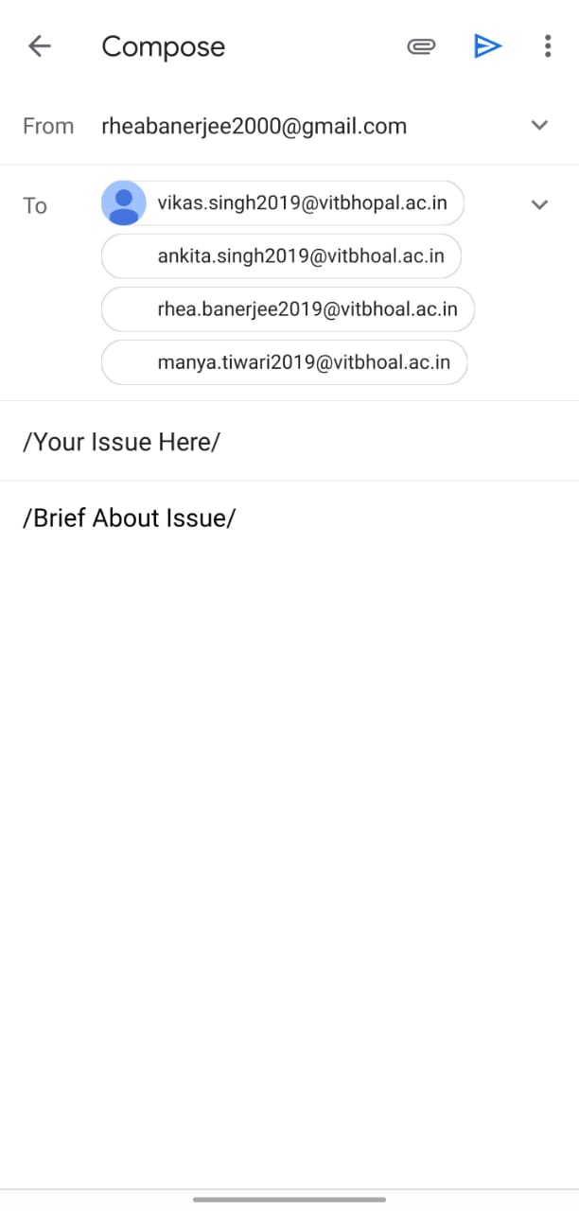
.
EMAIL IDs OF THE CREATORS
INFORMATION ABOUT THE APP
STANDARD FORMAT
THIS PAGE OPENS WHEN THE 'ABOUT' BUTTON IS CLICKED AND HAS ALL THE INFORMATION REGARDING THE CREATORS.
THIS PAGE OPENS WHEN THE HELP BUTTON IS CLICKED AND ALL THE EMAIL IDs OF THE CREATORS ARE AVAILABLE ALONG WITH A STANDARD FORMAT

Slide 15
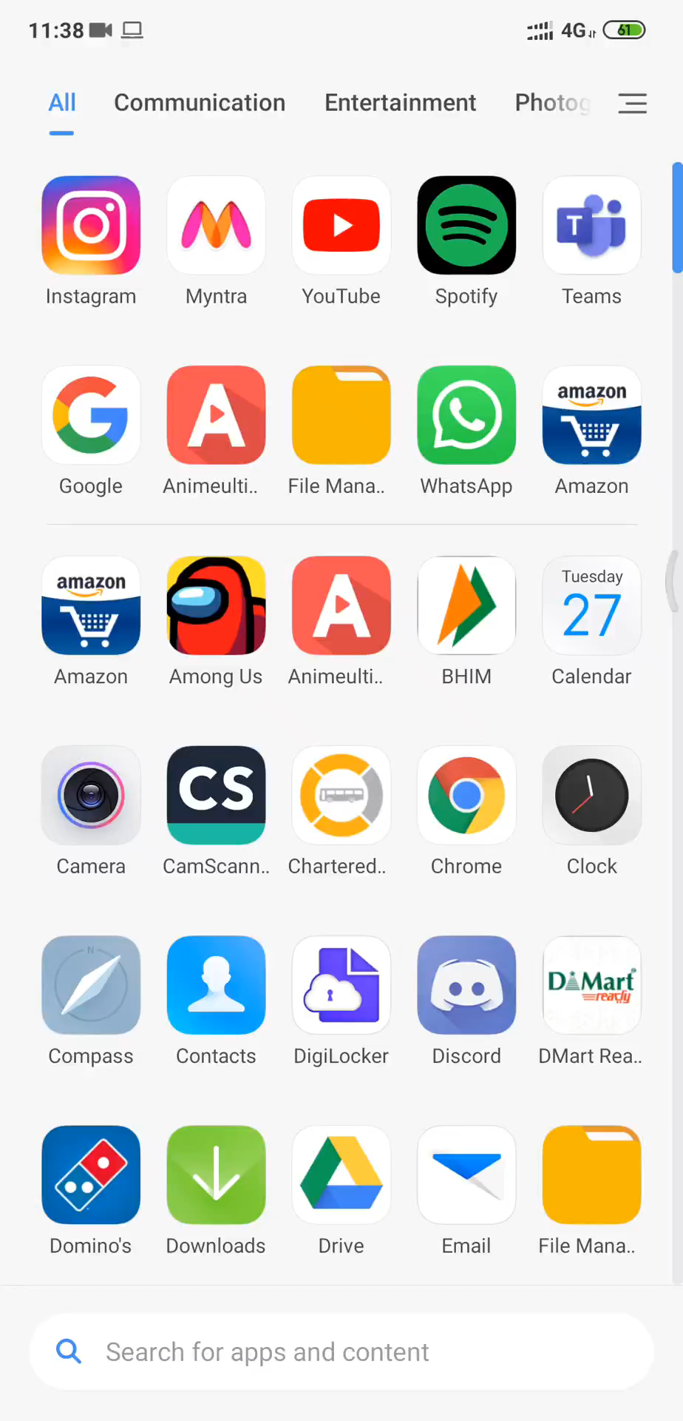
TESTING
DESIRED OUPUT – The button clicked on should open without any error or hassle.
ACTUAL OUTPUT – The desired output matches with the actual output as it is clearly seen in the attached video that the buttons when clicked on, open without any error.
*******************************************************************************************
DESIRED OUTPUT – Any changes done in the database should show in the application as well without any error.
ACTUAL OUTPUT – The desired output matches with the actual output as it is clearly seen in the video attached that when any change is done in the database it can seen in the application without any errors.
CONCLUSION –
Our application passes all the main parameters that we set.

Slide 16

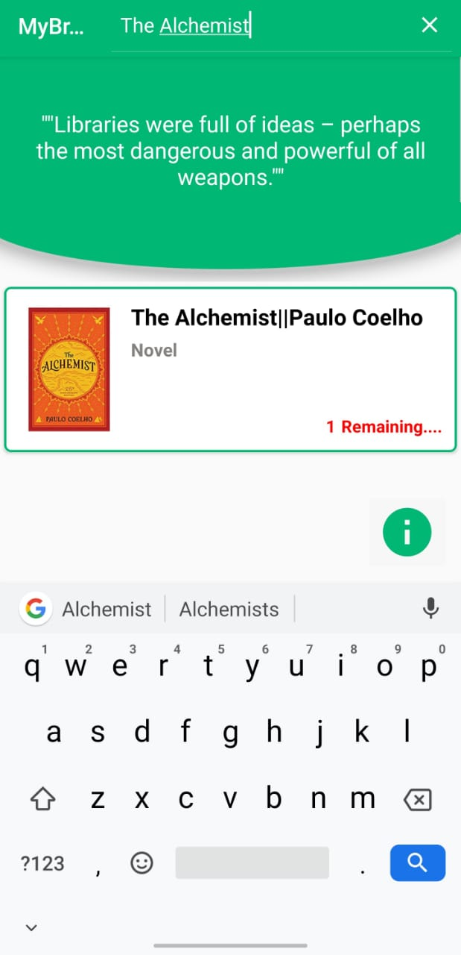
RESULT AND DISCUSSION
WE SEARCH THE DESIRED BOOK IN THE SEARCH BAR
HERE WE GET THE BOOK WE SEARCHED FO IN THE SEARCH BAR
ALONG WITH THE COUNT OF BOOKS REMAINING THE LIBRARY.
THE SAME CAN BE DONE FOR THE OTHER BOOKS AVAILABLE IN THE DATABASE.

